Slide 1

Decision on Customer Creditability
1

Slide 2



Our Team
Tim Strohmenger
Lars C. Gauch
ID: 20242075
Project Distribution: 1/3
ID: 20242082
Project Distribution: 1/3
Hakon Rosenberger
ID: 20242065
Project Distribution: 1/3
2

Slide 3

Our bank
Nexus Credit Bank
US-based, local bank
Special focus on offering investment
options for private real-estate
Relatively low margin and high pressure
of the competitive market
Need for a reliable decision, if loan
application should be approved, as
fail in complying leads to massive
economic losses
Not “too big to fail”
3

Slide 4
Table of contents
01
02
05
06
03
Explanatory Data Analysis (EDA)
Business Case
04
Introduction to the context and goal setting
What knowledge does our
Data consist?
Nature of Data
Modelling & Evaluation
What characteristics does our dataset have?
What techniques have we used and which performed best?
Conclusion
Data Preprocessing and Feature Engineering
How have we prepared our data for the analysis?
What business implication can be drawn for both perspectives?
4

Slide 5

01
Our Business Case
How can a bank decide, if they should give a customer a real-estate loan?

Slide 6
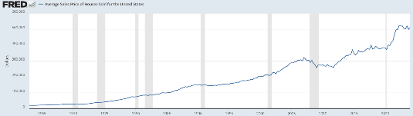
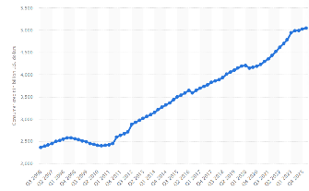
Real-Estate Market challenges customers and financial institutes…
Consistantly and rapidly increasing housing prices in the US (Graphic 1)
→ Major driver for increasing demand of high valued loans (Graphic 2)
→ Huge volumes of offered loans increase financial risks of banks
=> Reliable prediction on creditability of applicant is of
high importance for banks
6

Slide 7


Goal setting for this project
training and testing a machine learning model for prediction of creditability by using classification techniques
Maximize Accuracy in Prediction
Reduce risks for costs of missclassification
Fasten the decision on loan approval
7

Slide 8

02
Nature of Data
What dataset have we used and what
characteristics does it have?

Slide 9
Nature of Data
Source | Kaggle.com: Free sharing and adaption for educational usage (Attribution 4.0 International License)
Dataset Origin | Dataset was explicitly created for the data science use case of deciding on property loans
382
13
Number of
total observations
Count of feature
columns
9

Slide 10
Configuration of the Data Features
Categorical Information
SemiOrdinal Information
Numerical Information
Loan_ID (unique)
Gender (m,f)
Married (Y,N)
Education
Self_Employed (Y,N)
Credit_History
Property_Area
Dependents
→ ordinal rank for 0-2
=> values above 3
collected as 3+
ApplicantIncome
CoapplicantIncome
LoanAmount
Loan_Amount_Term
Y -> yes; N -> no
m -> male; f -> false
10

Slide 11
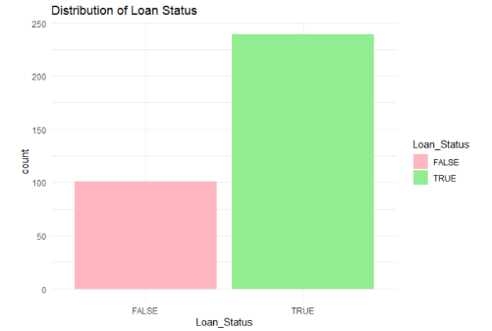
Our Target Variable
Loan Status
Categorical attribute, that represents
decision on loan approval
→ Y for approval, N for rejection
Purpose
High accuracy/precision in prediction of
loan status by using independent
features for classification approach
11

Slide 12
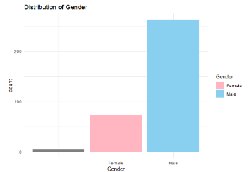
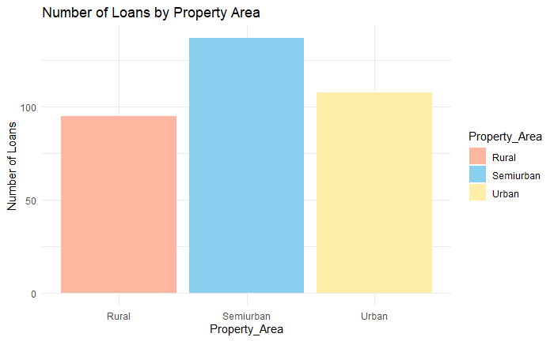
Distributions of further attributes
Majority of male applicants
Suprisingly equalized amount of loans
for different housing regions
12

Slide 13

03
Data Preprocessing & Feature Engineering
What steps do we perform in order to prepare our dataset for the analysis?

Slide 14
Key Steps of Preprocessing
01
Data Cleaning
Handling of missing values
02
Data Transformation
Transformation of some raw feature values
Scaling and Encoding of Data
13

Slide 15
Handling of Missing Values
Running of a search algorithm to detect missing feature values within our dataset
→ Required caution in removing of data, due to relatively low size of dataset
→ Detection of 41 data entries with missing values (30 missing values for Credit_History)
Decision to drop all data entries with missing values for
credit_history (expected high feature importance and
limitations in handling of categorical information)
14

Slide 16
Transformation of raw data features
Usage of the method mutate() to prepare the values of our categorical features for our data analysis:
→ Conversion of ‘Education‘ ,‘Married‘ and ‘Self_Employed‘ into logical variables
(‘Yes‘/‘Graduate‘ => TRUE ; ‘No‘ => FALSE)
→ Conversion of ‘Gender‘, ‘Dependents‘ and ‘Property_Area‘ into factors
Intention: Improving options for statistical modeling and facilitation
of machine learning workflows
15

Slide 17
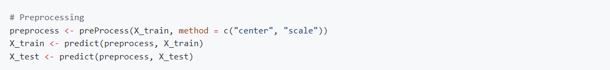
Scaling of Numerical Data
Important standardization of our numerical feature values is achieved within the method preProcess()
→ Necessary to ensure equal feature contribute to the model
1. Centering: Subtraction mean value from each feature value to
center the values around 0
2. Scaling: Division of each feature value with the standard deviation of
the feature
17

Slide 18
Feature Engineering
Integration of two new data features to improve the performance in prediction on approval decisions and the understanding of decision rules
Total_Income
Sum of Applicant‘s and Co-Applicant‘s
Income
Income_To_Loan
Total_Income divided by LoanAmount
Major identifier for financial stability of applicants, as it brings
regular income in relation to amount, that needs to be repayed
(The higher, the more likely is the application to be approved)
18

Slide 19

04
Exploratory Data Analysis (EDA)
What knowledge and inferences can we
gather by visualizing and understanding
our data structure?

Slide 20
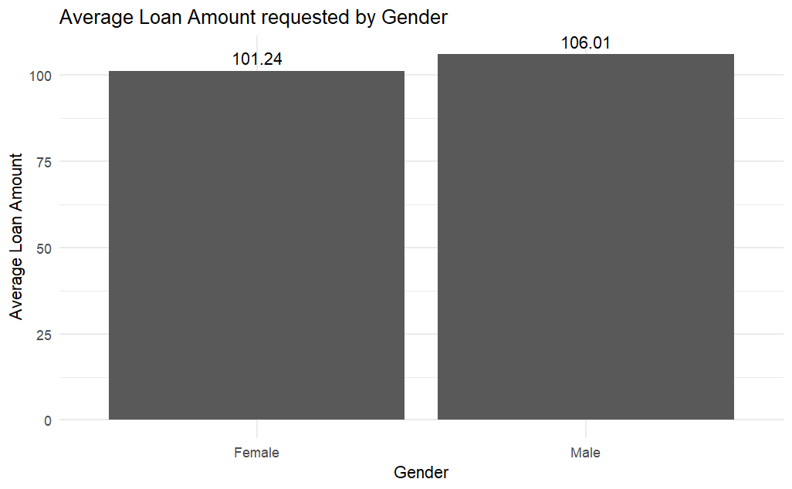
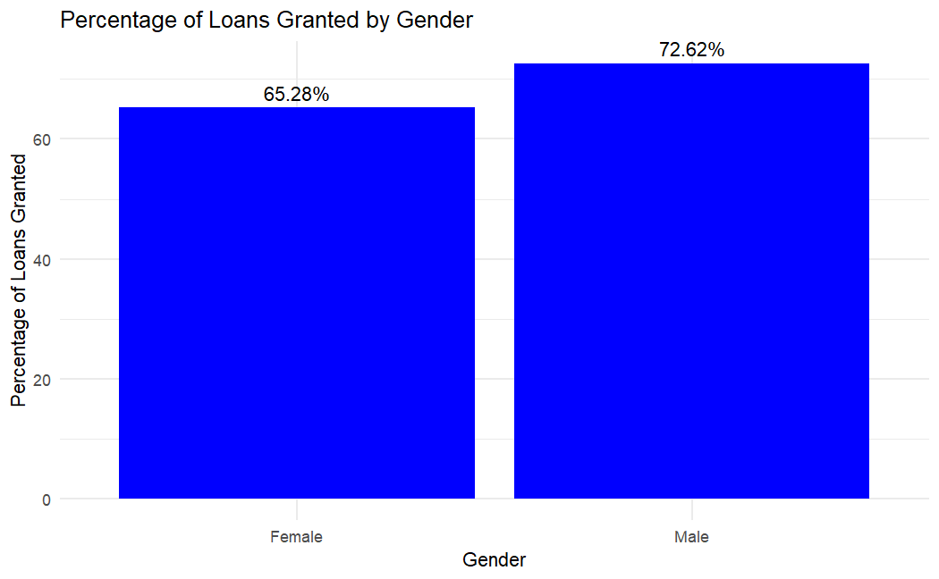
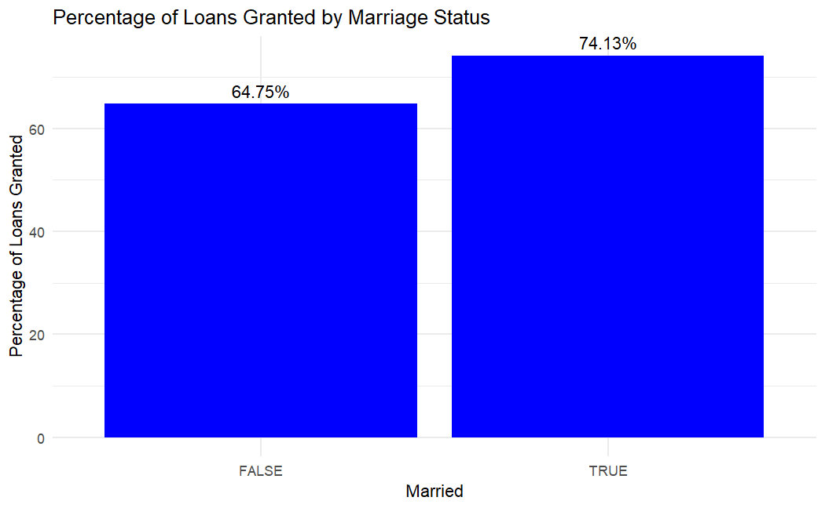
Gender
20

Slide 21
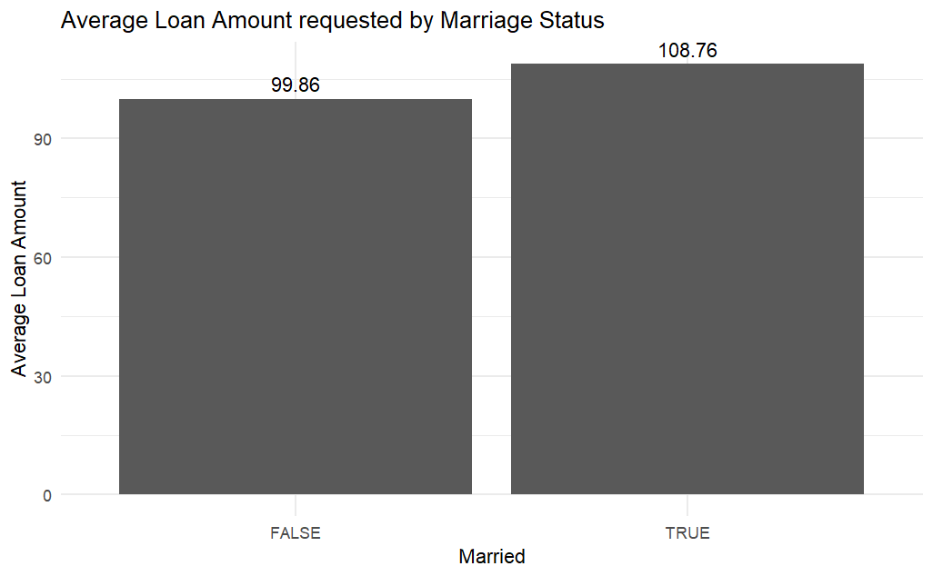
Marriage Status
21

Slide 22
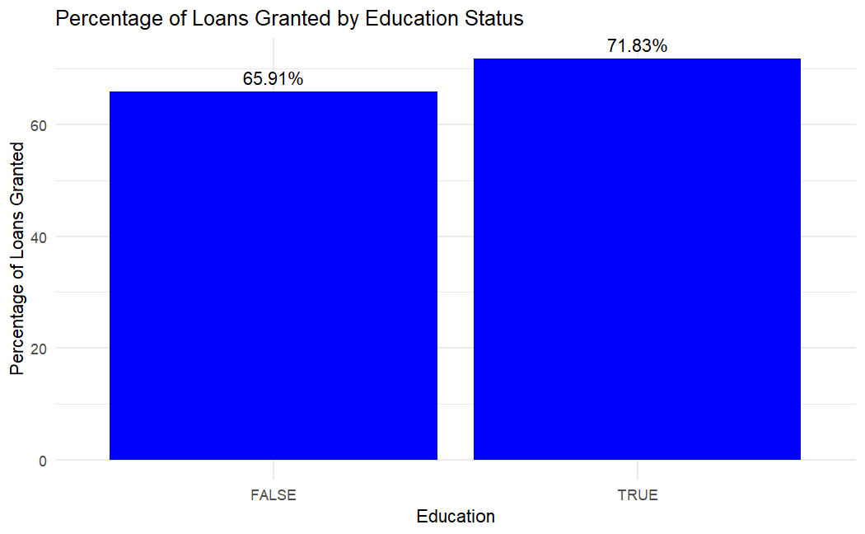
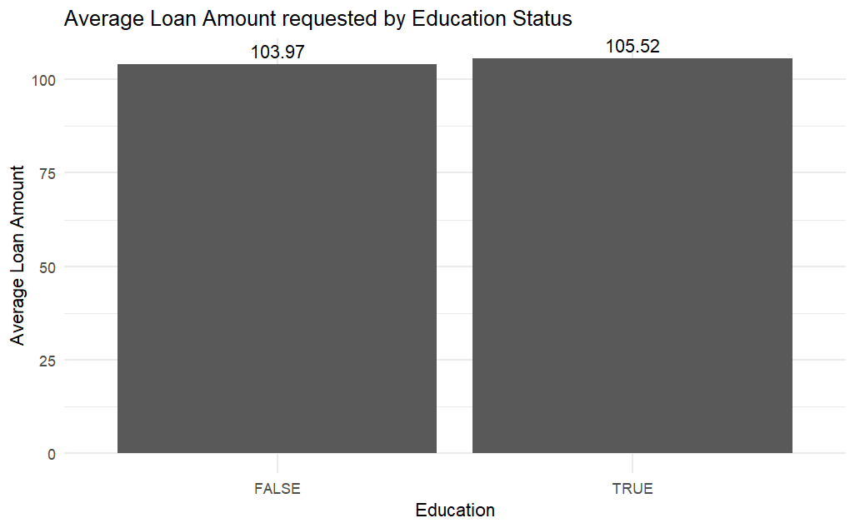
Education
22

Slide 23
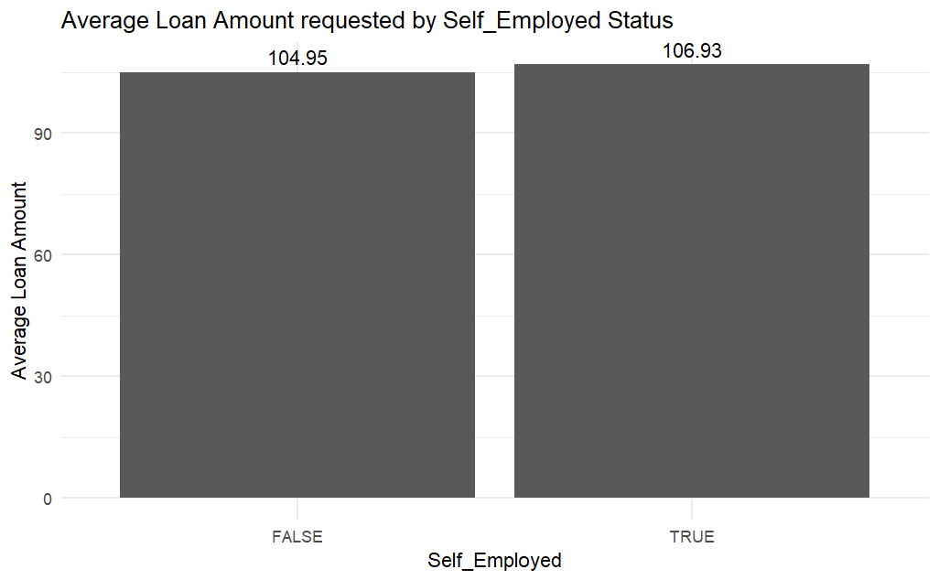
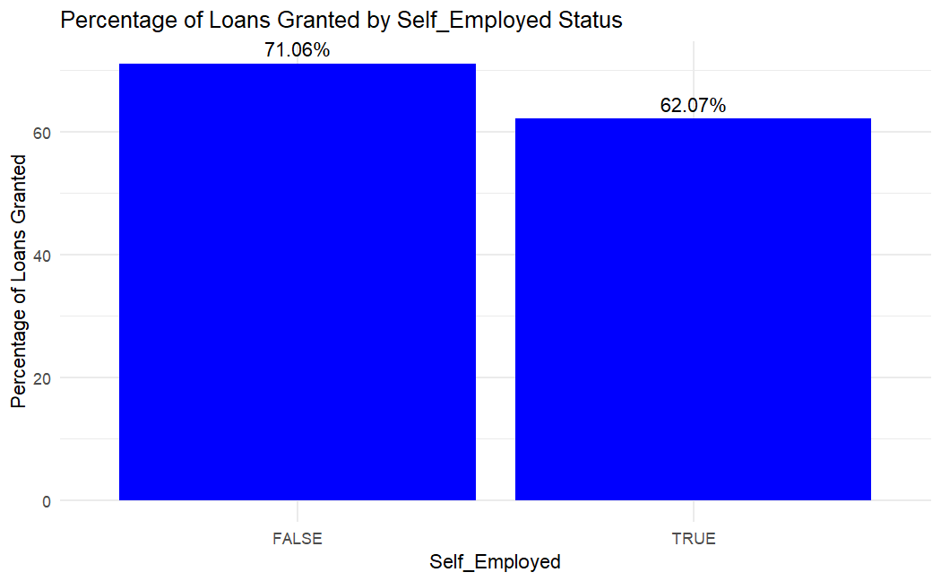
Self-Employment
23

Slide 24
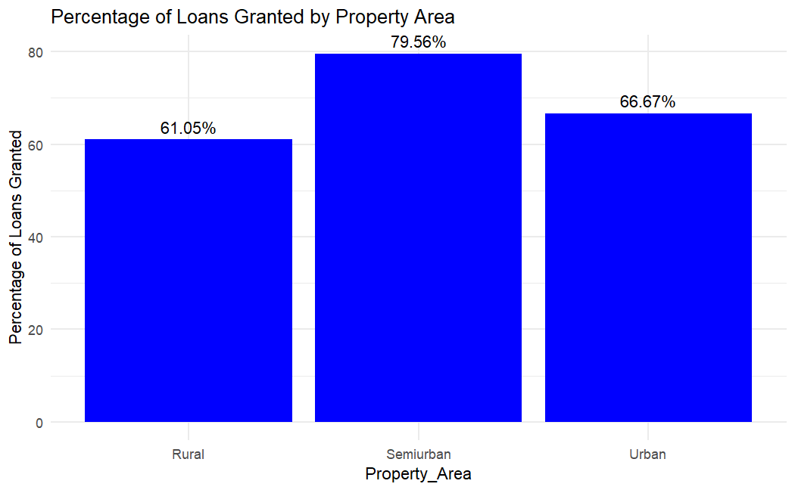
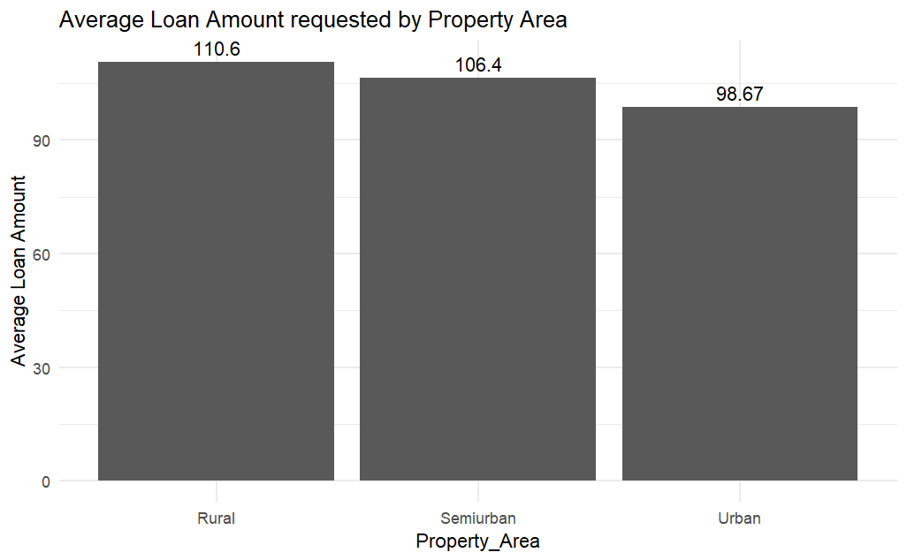
Property Area
24

Slide 25
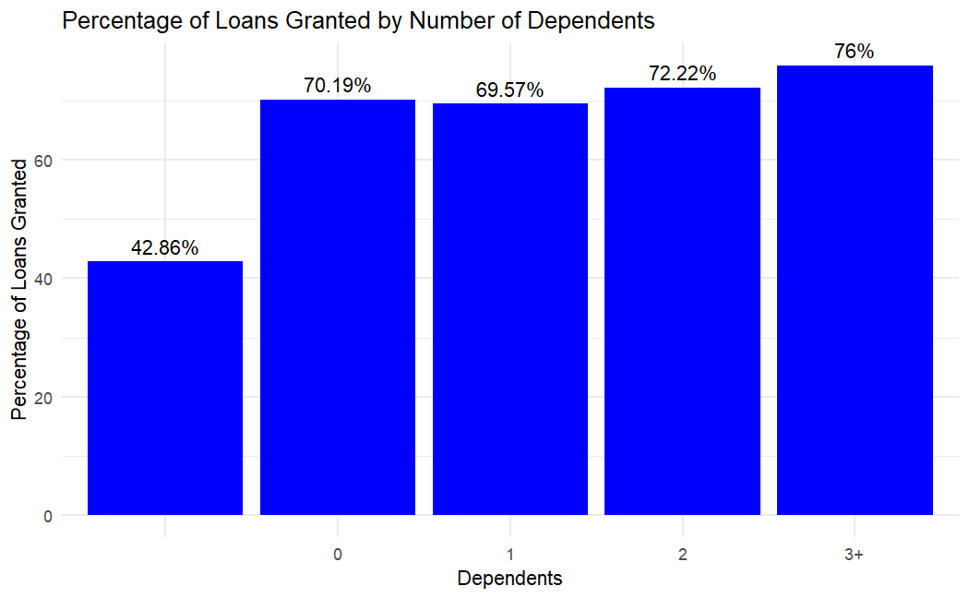
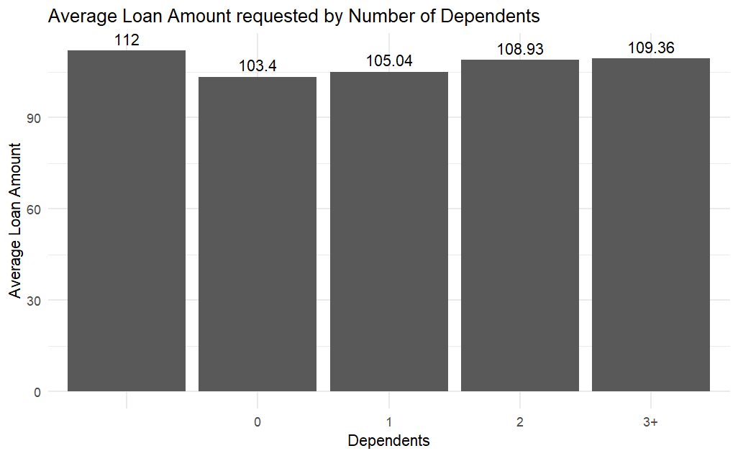
Number of Dependents
25

Slide 26
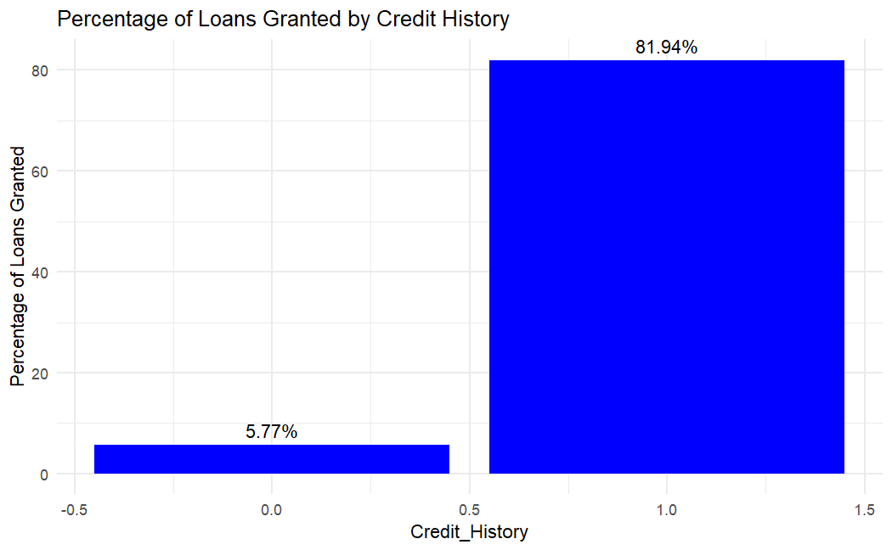
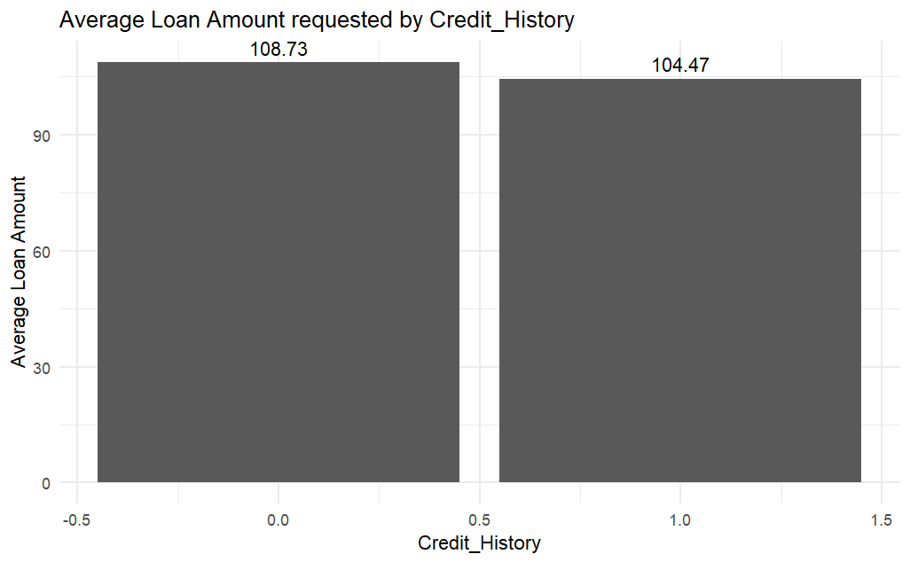
Credit History
26

Slide 27
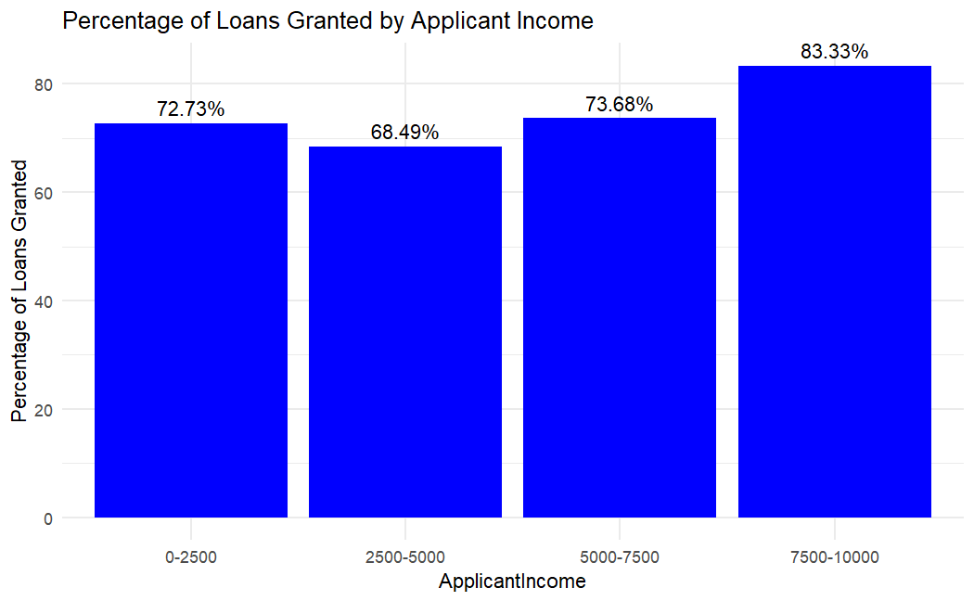
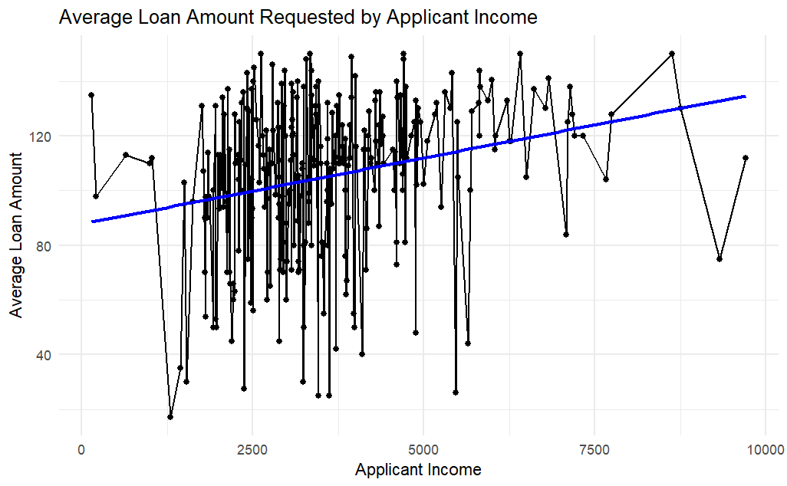
Applicant Income
27

Slide 28
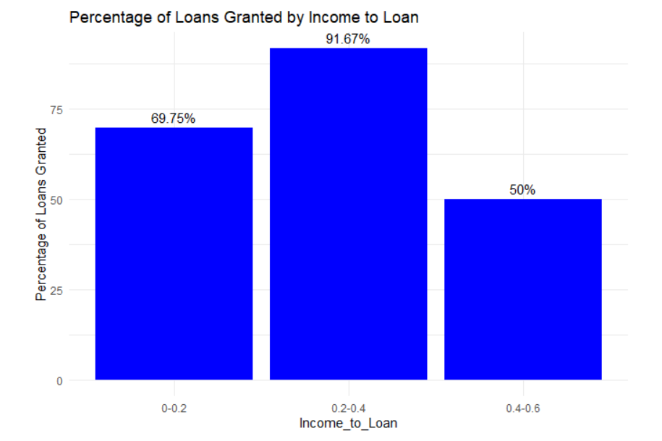
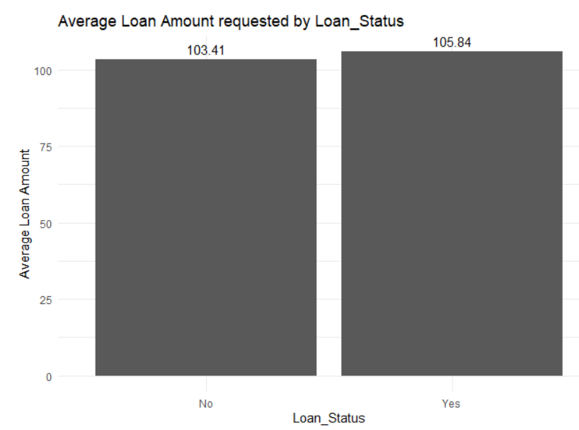
Additional Statistics
28

Slide 29

05
Modelling & Evaluation of results
What classification techniques have we used and what results have we received?

Slide 30



Used Classification Algorithms
Decision Tree
Classifier
K-Nearest-Neighbours
(KNN)
Random Forest
Classifier
30

Slide 31
Focused KPIs for model evaluation
Accuracy
Precision
Percentual ratio of
correct predictions on loan approval
Percentual ratio of
correctly approved loans
in relation to all approvals
ROC Curve / AUC Value
Evaluating the model
by bringing TPR and FPR
in relation
31

Slide 32
Creation of Training & Test Dataset
regular training_test_split by using the following setting and k-fold cross validation on training set
80%
20%
Training-Set Size
Test-Set Size
10
Number of used cross-validation folds
32

Slide 33
Hyperparameter Tuning
Using of Grid Search for the optimization of following used hyperparameters…
mtry
Node size
Number of tried
Variables per split
→ c(2, 4, 6, 8, 16)
Maximum number of
terminal tree nodes
→ c(1, 5, 10, 20)
ntree
Number of used trees
in the forest
→ c(100, 200, 300, 500)
Only used for Random Forest
33

Slide 34
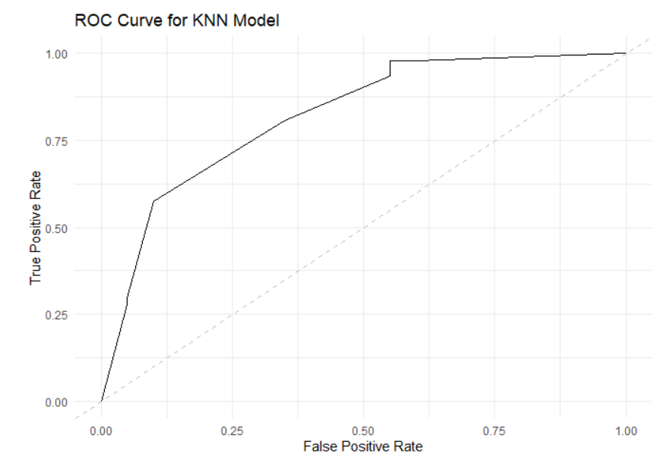
Performance of the different models
K-Nearest-Neighbors
(KNN)
Accuracy: 84,29%
Precision: 90,0%
AUC: 0.8207
34

Slide 35

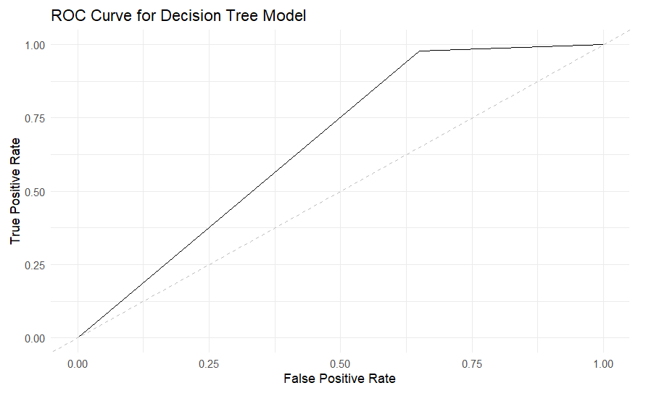
Performance of the different models
Accuracy: 84,20%
Precision: 90,0%
AUC: 0.7144
35

Slide 36
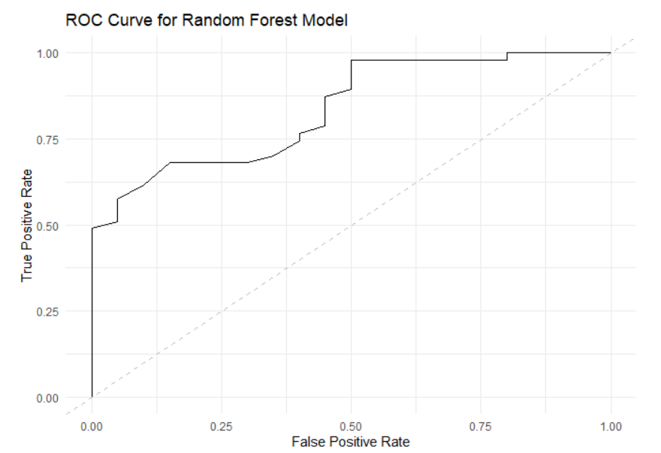
Performance of the different models
Random Forest
Accuracy: 83,52%
Precision: 91,0%
AUC: 0,8367
36

Slide 37
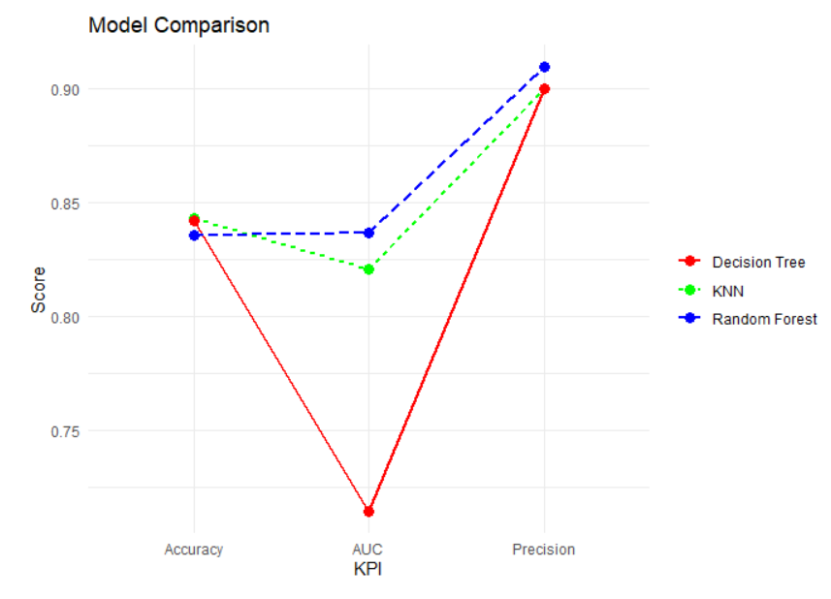

Identification of the best model
→ Generally well and quite
equalized performance
from all three models
→ KNN is about to produce
the highest accuracy
Due to major importance of a
high precision value, we would
recommend to choose
Random Forest
37

Slide 38
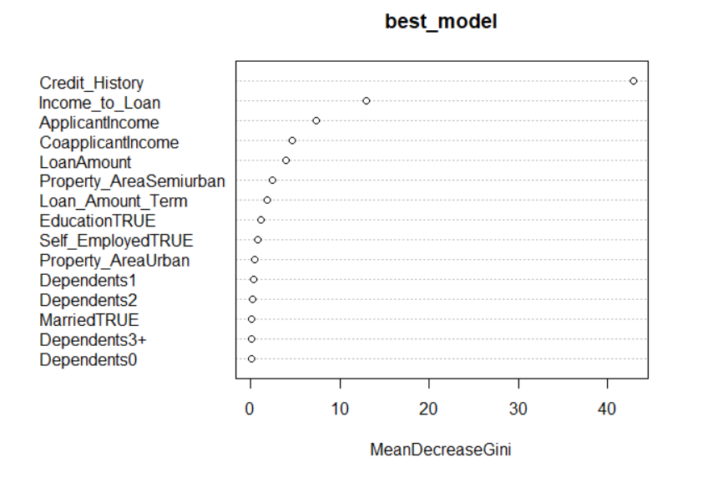
Assessment of most important features
→ Expected high
importance of
Credit_History
→ High importance of
engineered
Income_to_Loan
=> represent financial
stability in the best
way
→ Relatively low
importance of clear
categorical variables
(e.g. married,
Property area)
38

Slide 39

06
Conclusion
What business implication can be drawn for
both perspectives?

Slide 40

Drawn Business Implications
Potential for high predictability on loan approval
Reduce risks for costs of missclassification
Fasten the decision on loan approval
40

Slide 41



Limitations and Future Potential
Limitation of model efficiency, due to relatively low sample size (382 data entries)
→ Potential improvement with higher available data size in the future
Potential subliment for bank employees for decision process
→ Human checks are still required
Increase number usable data feature
41

Slide 42


Applicant‘s Perspective
Importance of a impeccable credit history (highest feature importance value)
Flexibility in location of related property (urban, semi-urban or rural)
→ Banks offers fair options for all areas
Delivering of a faster and twice secured application progress
→ Employees can focus most important checks and algorithms limit
potential sources of human failure
42

Slide 43

Thanks!
Do you have any questions?
Please keep this slide for attribution

Slide 44
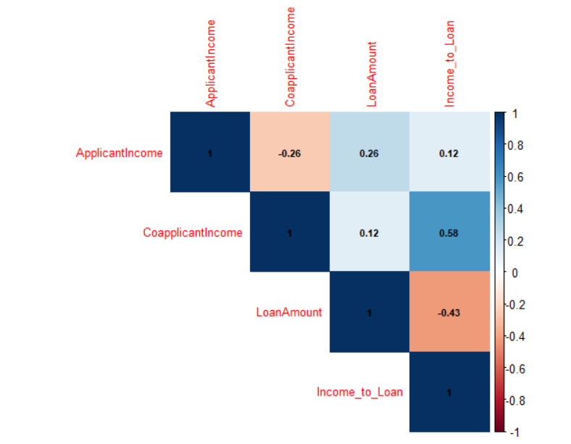

Slide 45
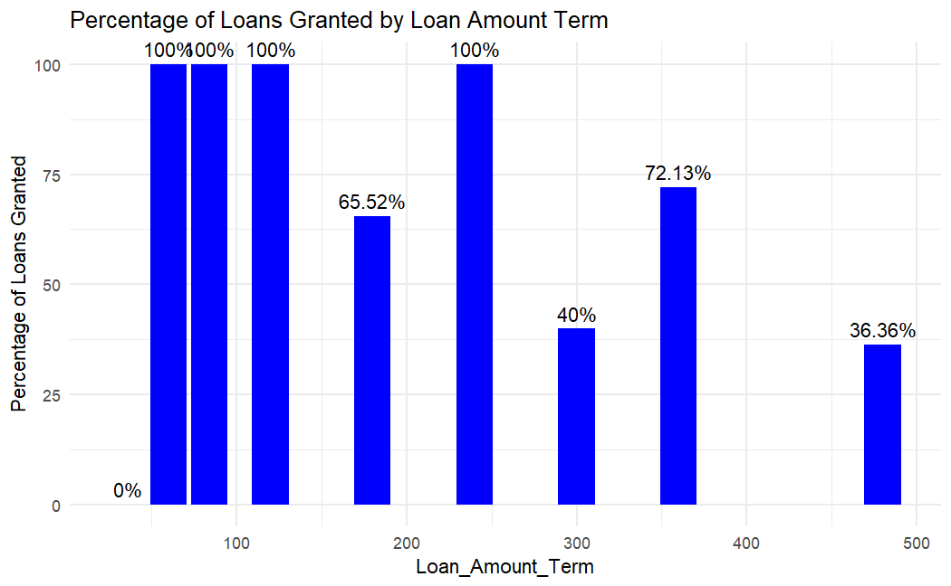
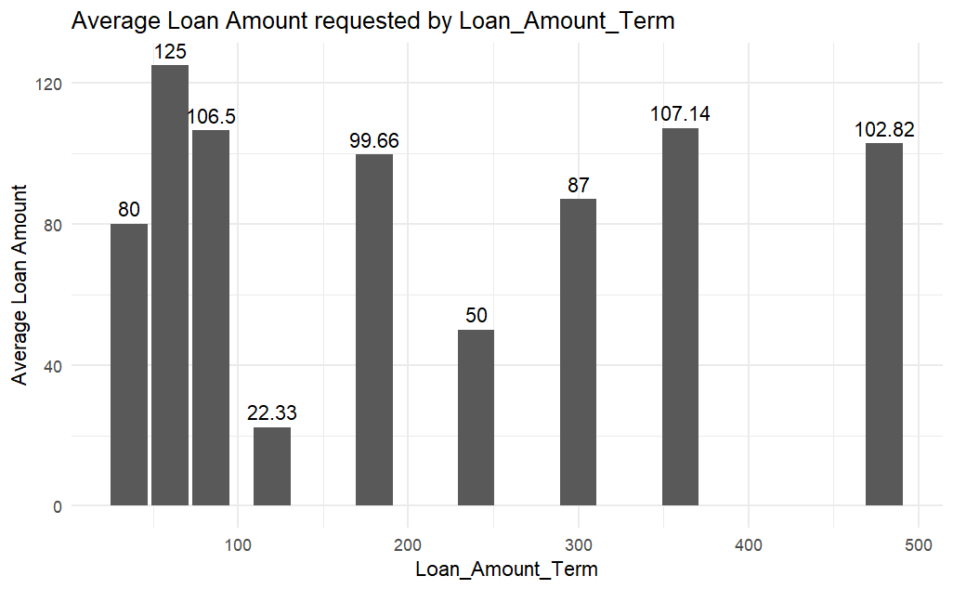
Loan Amount Term

Slide 46
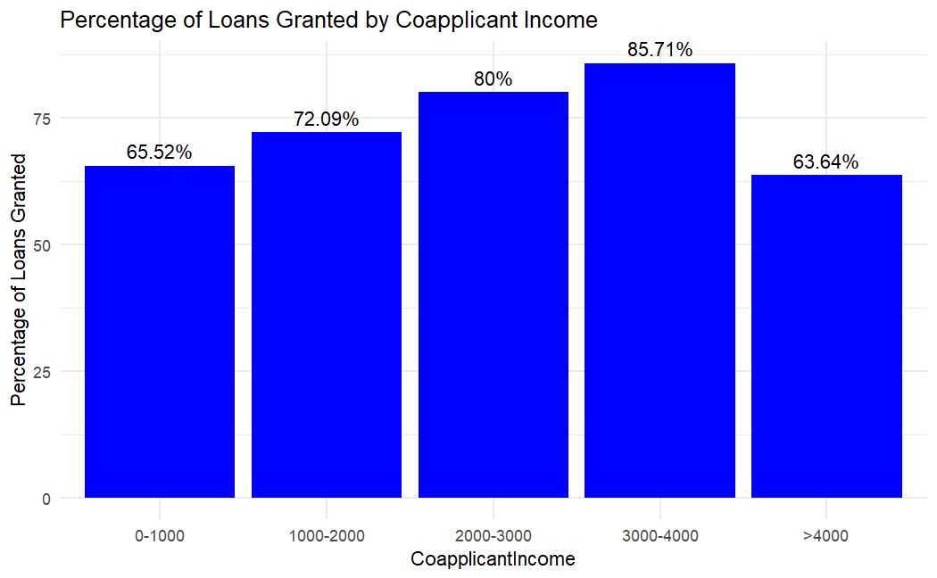
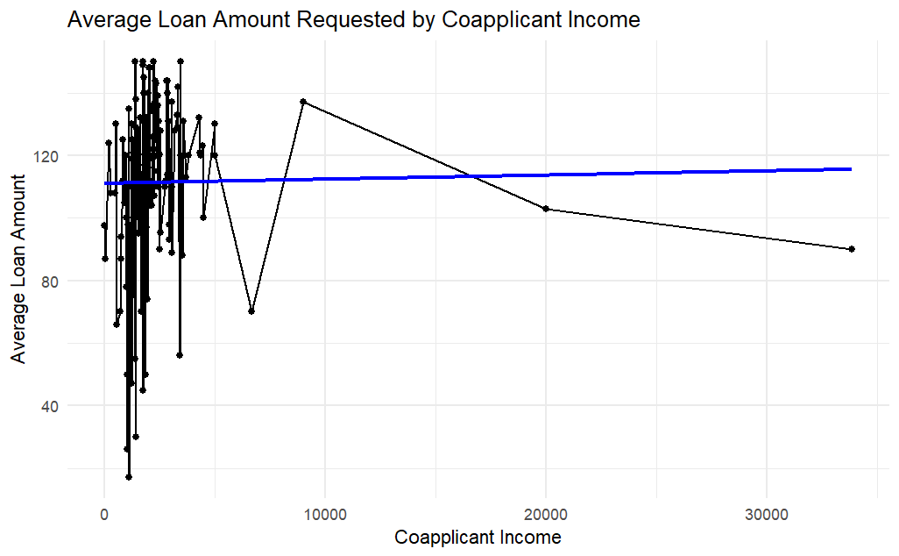
Coapplicant Income

Slide 47
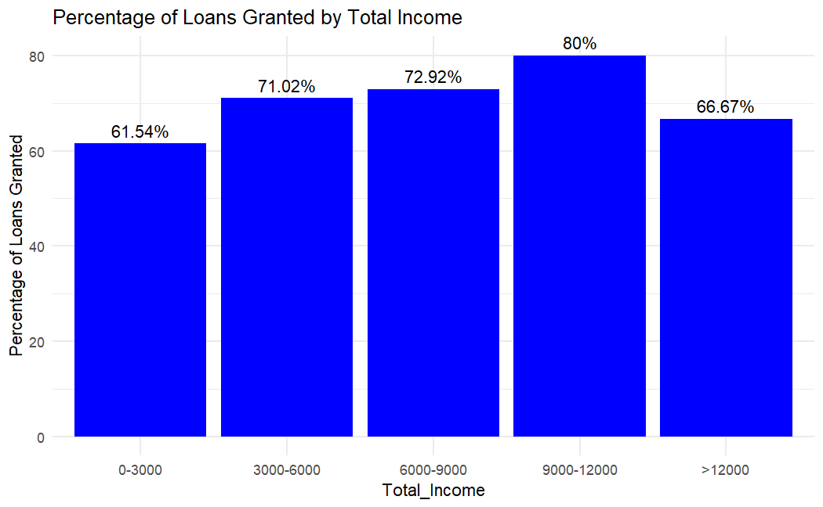
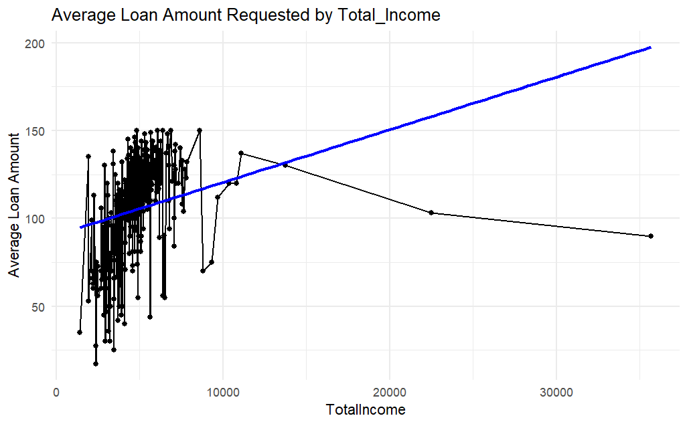
Total Income

